Slide 1

Predicting Cancelations for the Hospitality Industry
Business Cases With Data Science
Henrique Costa
Pedro Mendes
Rafael Soromenho
Rui Soromenho

Slide 2

Project Overview
Why?
Lost revenue
Innefective strategies
What?
Reduce cancelation rate
Forecast Net Demand
How?
Key Insights
Business Implementation
Predictive Model
Notes:
Our goal today is to explore a path forward in managing cancelations and overcoming the challenges they have been presenting to the hotel industry.
Cancelations not only have caused lost revenue and many other operational difficulties for your teams, but also the classic strategies that have been attempted to manage them such as overbooking or applying more restrictive cancelation policies have proven ineffective.
We believe the answer to control cancelations is in using data.
To convince you of this as well we will walk through 3 steps in the next 4 minutes.
Starting with our cancelations understanding cockpit we will share insights on cancelation drivers and how they connect to the business strategy while providing you a tool to explore the data yourselves.
We will then share the results of a machine learning predictive model that was developed to accurately identify bookings with high likelihood of canceling.
Finally we will discuss how this tool could be deployed and the different ways in which it could help you improve the hotel´s results.
Our PowerBI expert Pedro will now give you a sneak pick into the Cancelations Understanding Cockpit.

Slide 3

Cancelation Key Insights
Market Segment
Booking Features
Customer History
Seasonality
Cancelations Understanding
Cockpit
Notes:
We used Power BI dashboard for some very simple visualizations on key insights.
Our cockpit investigates 4 key areas that affect cancelation likelihood:
Market Segment
Seasonality
Booking features
Customer History

Slide 4
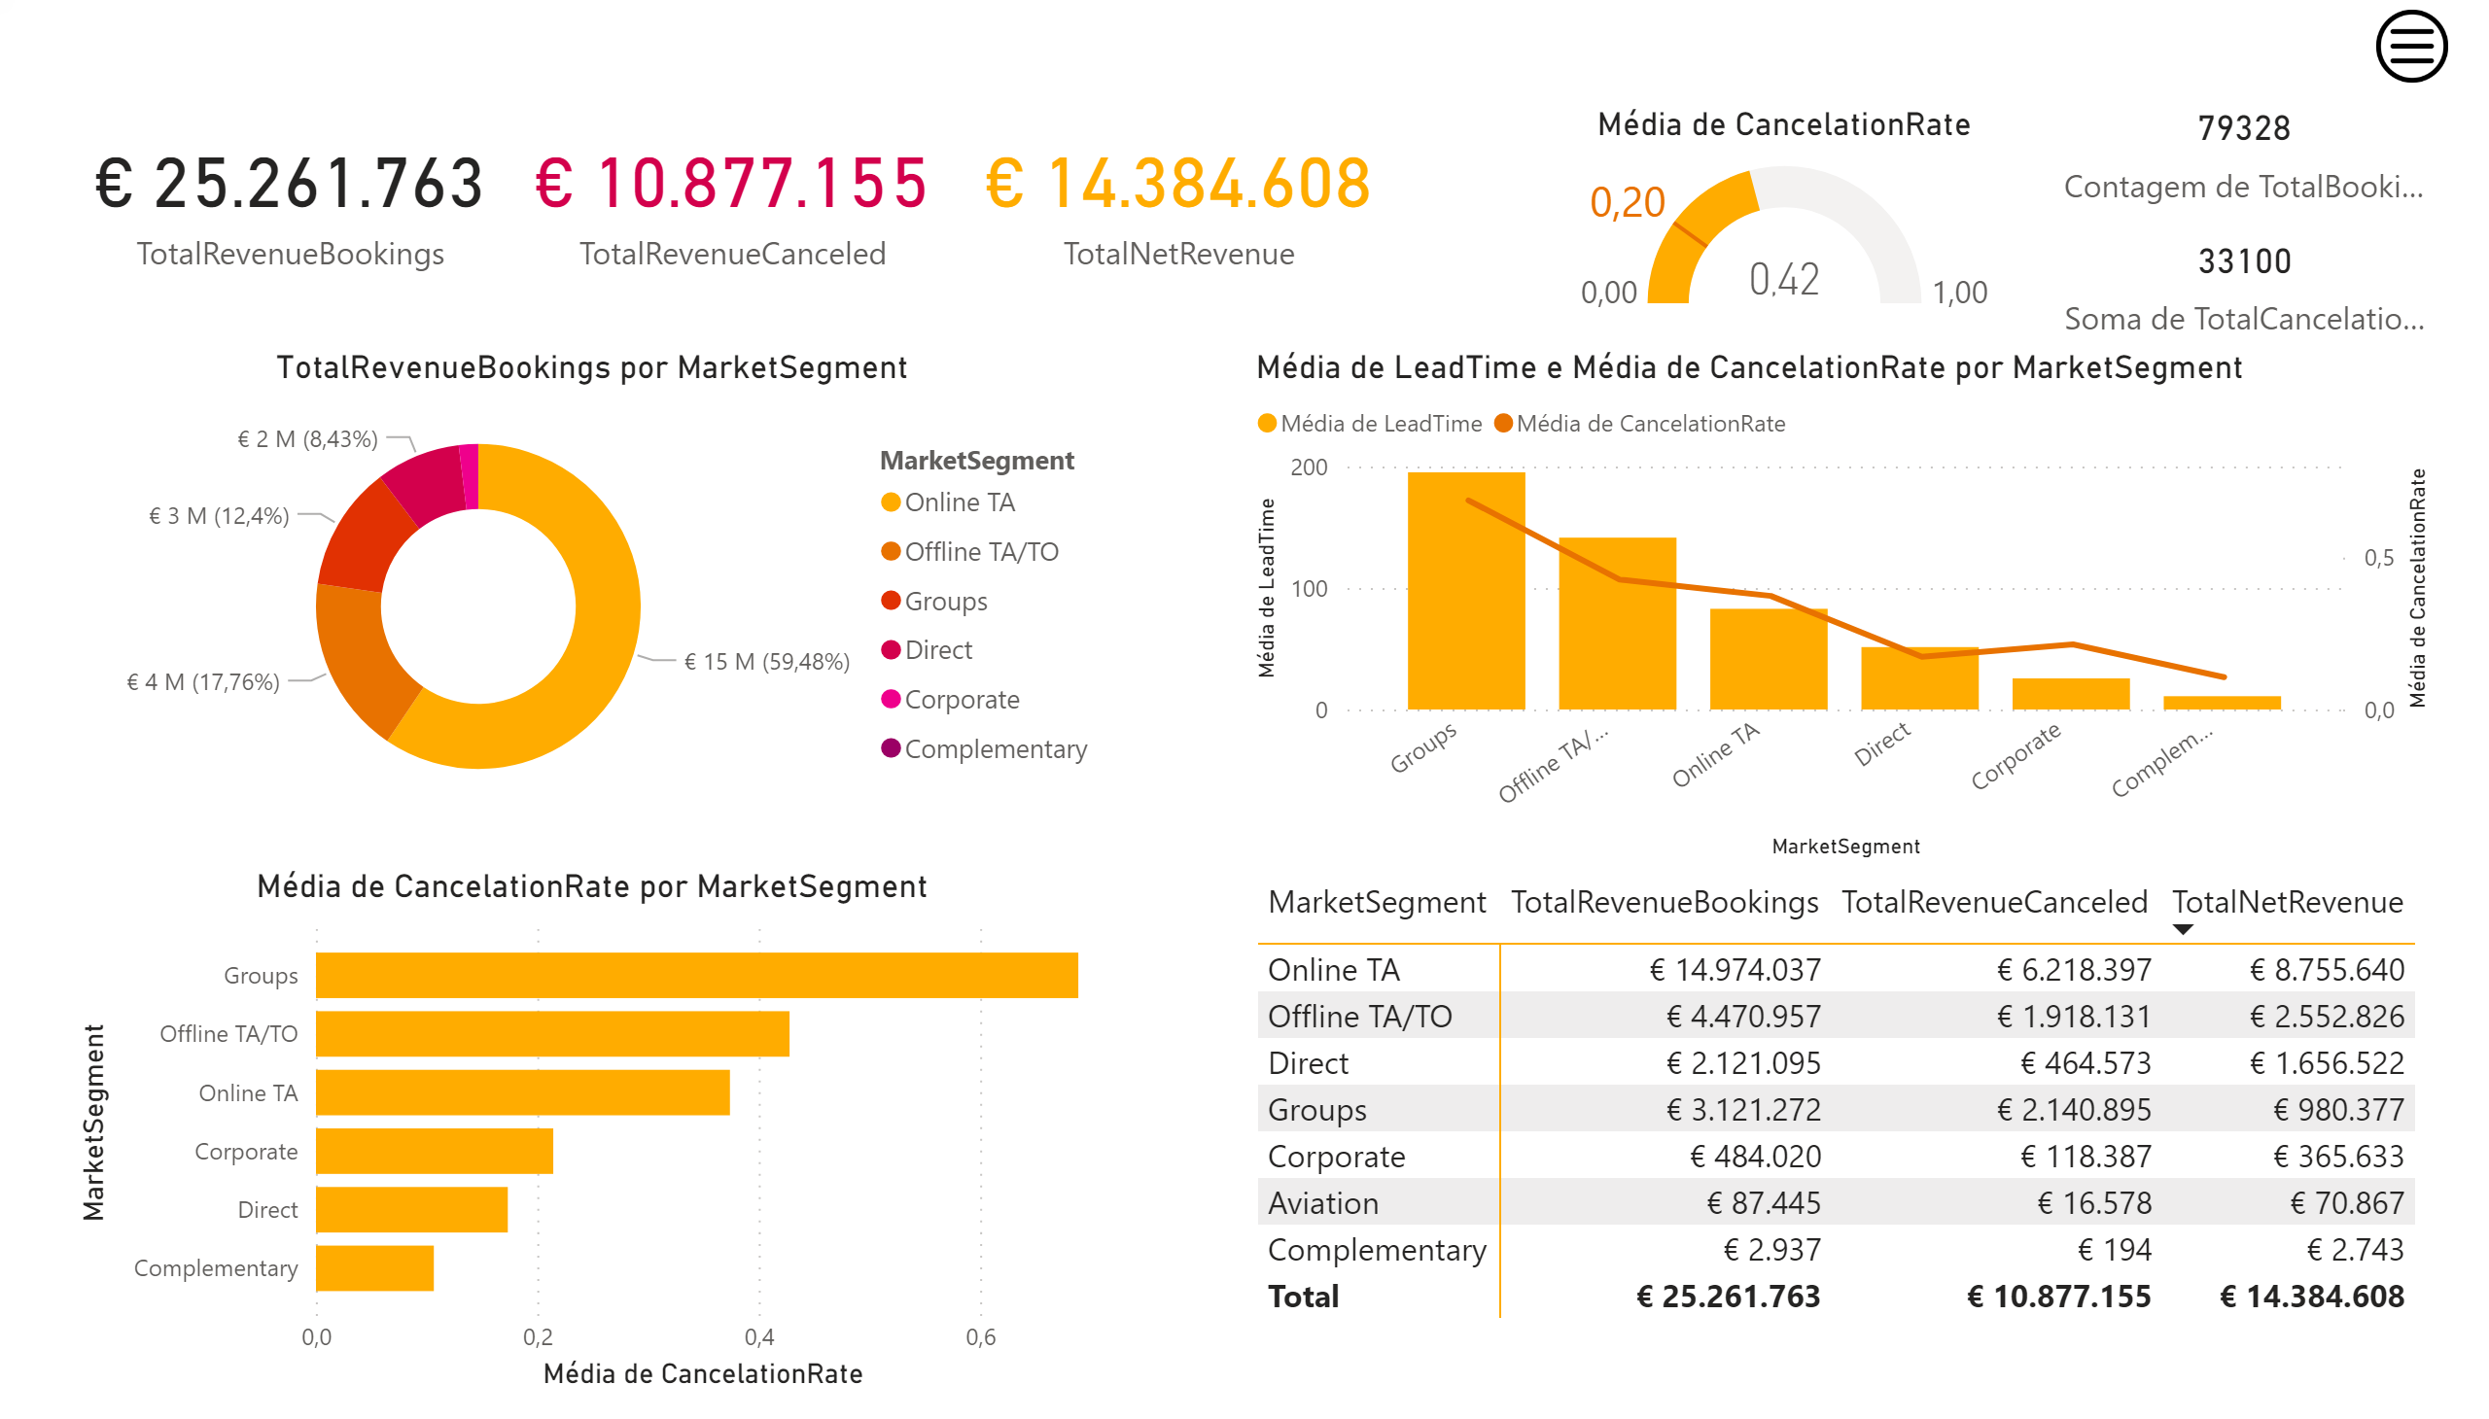

Market Segment
Market Segment Perspective
Notes:
First, I should call your attention for the current average cancelation rate of 42% which is twice as much as the hotel target of 20% as seen on the velocimeter graph
Certain market segments are closely connected with cancelation probability: Groups cancel 70% on average while direct bookings less than 20%.
We also observed that lead time and likelihood of a cancelation are highly correlated.

Slide 5
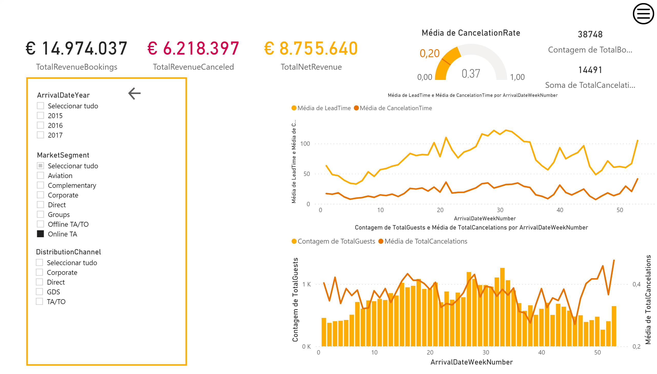
Time
Seasonality Perspective
Notes:
When talking about SEASONALITY
The time in advance when a cancelation is done seems to be connected to the lead time.
Cancelation Rate seems to through the year on a weekly basis and to have some connection with the overall seasonality of the bookings.

Slide 6
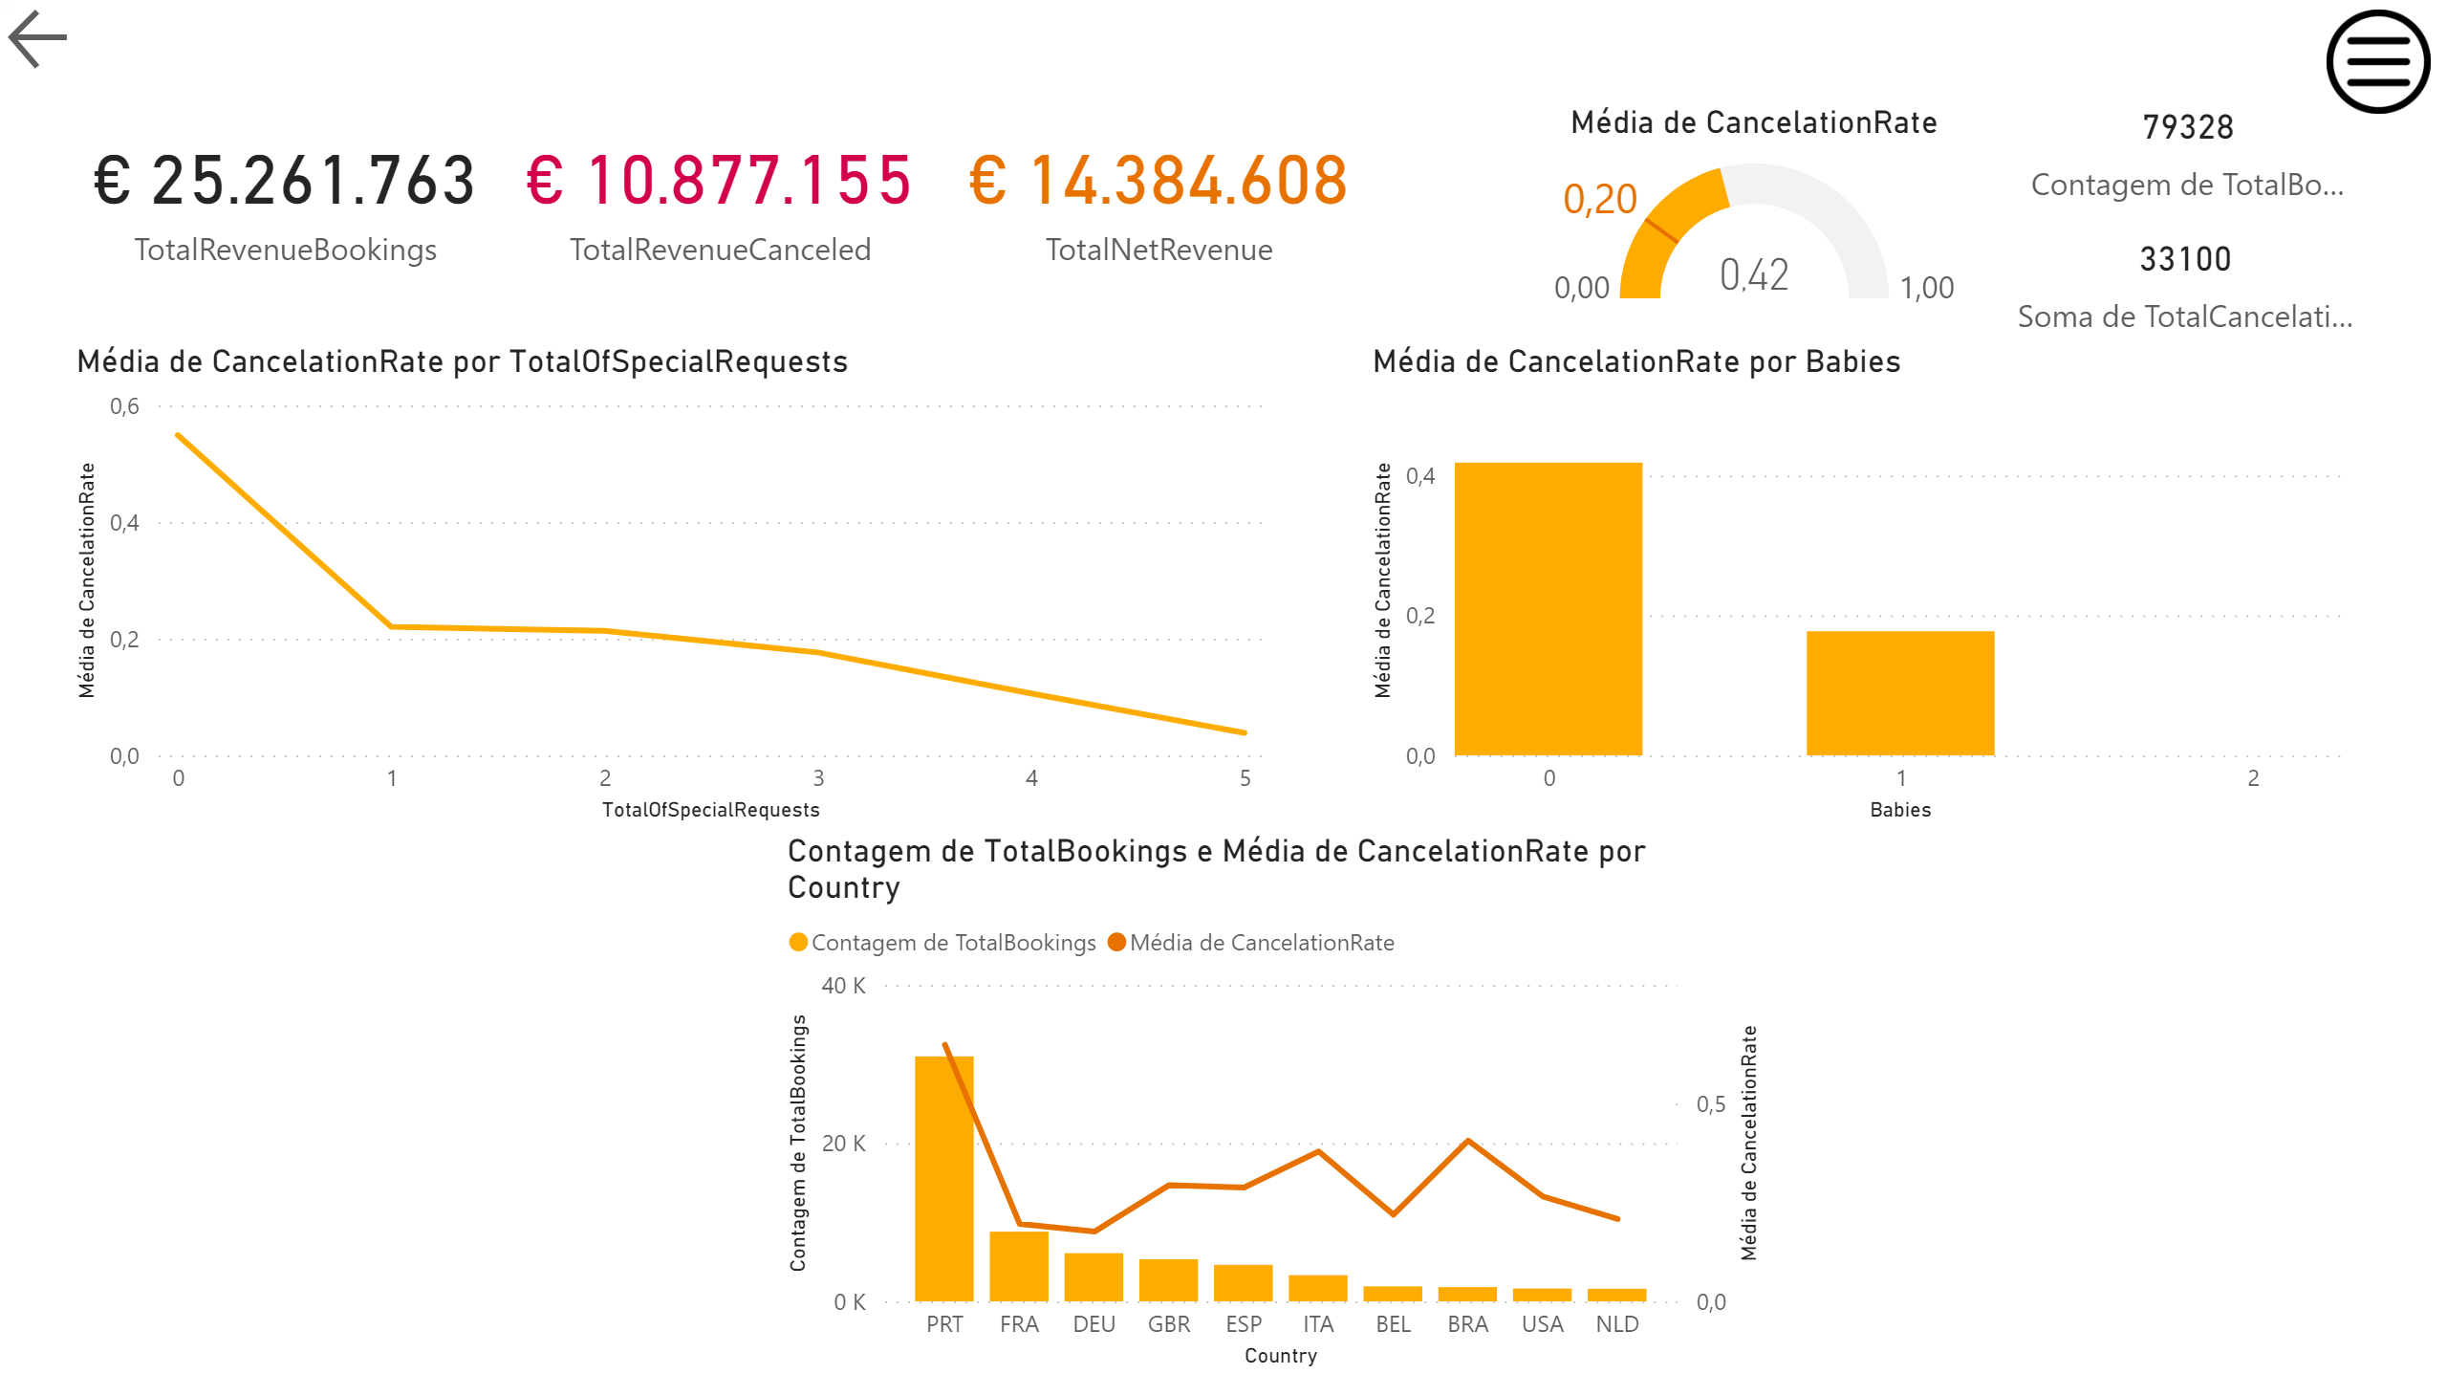
Booking characteristics
Booking Features Perspective
Notes:
In terms of main booking features, certain booking characteristics like having babies or making special requests indicate low likelihood of cancelation and are important features for predicting cancelations

Slide 7
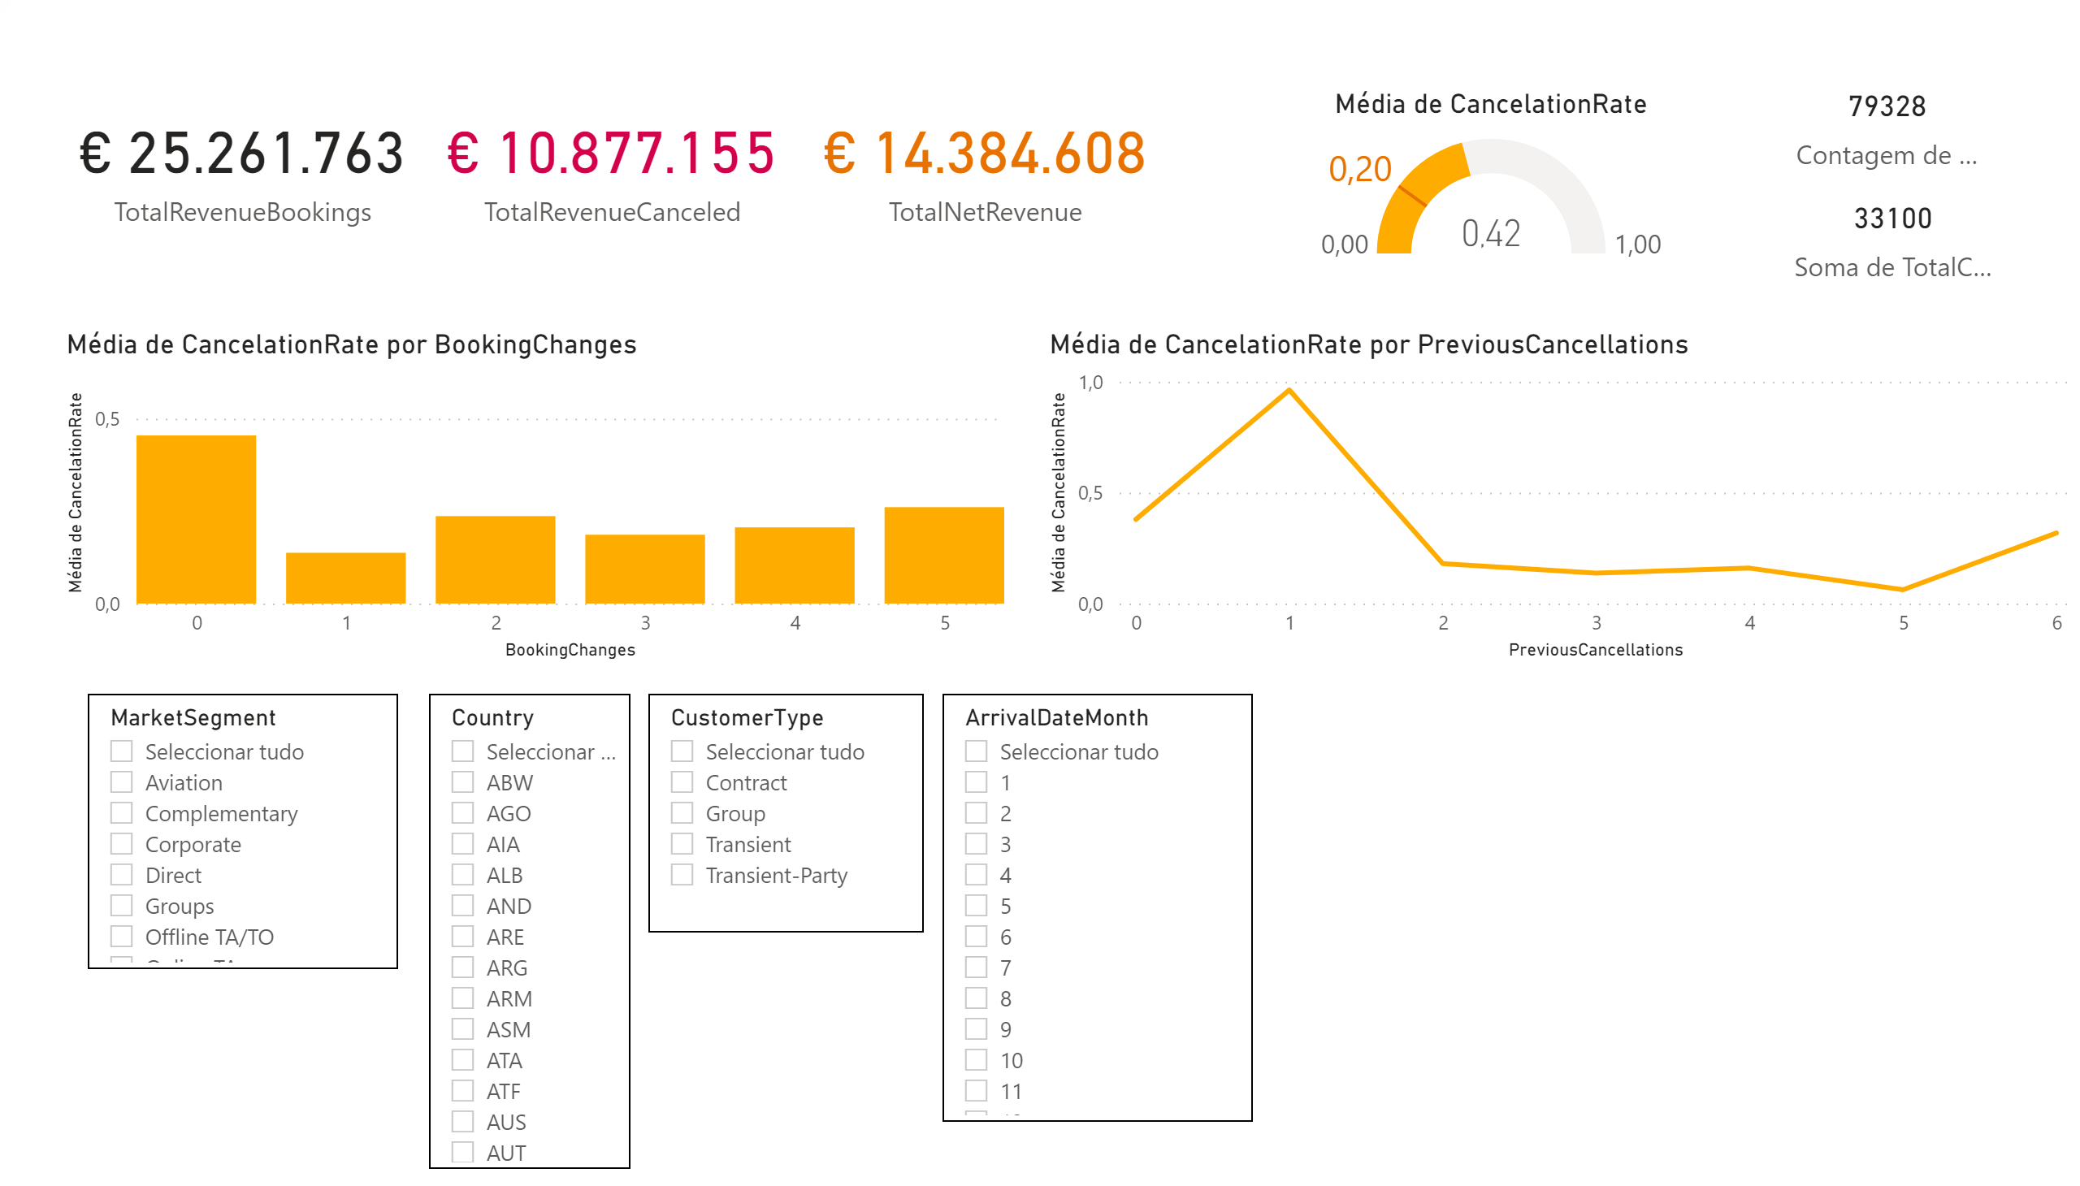
Customer History
Customer History Perspective
Notes:
Finally, Customers that have an history of previous cancelations are more likely to cancel again.
On the other hand, a history of booking changes indicates less chance of canceling.
After understanding some of the main insights on our data and what drives cancelations, we will now focus on our predictive model

Slide 8

Predicting Cancelations
88% accurate in predicting booking cancelations
GradientBoosting Machine Learning Algorithm
Notes:
The cancelations cockpit shows interesting insights but to combine all those factors to make a decision is almost impossible for the human brain.
That is why what we really did was building a machine learning model to predict cancellations.
The algorithm is called GradienBoosting and can predict cancelations with an accuracy of 88%. But more important than understanding the algorithm behind the model is to understand its capabilities and the corresponding business implications.

Slide 9



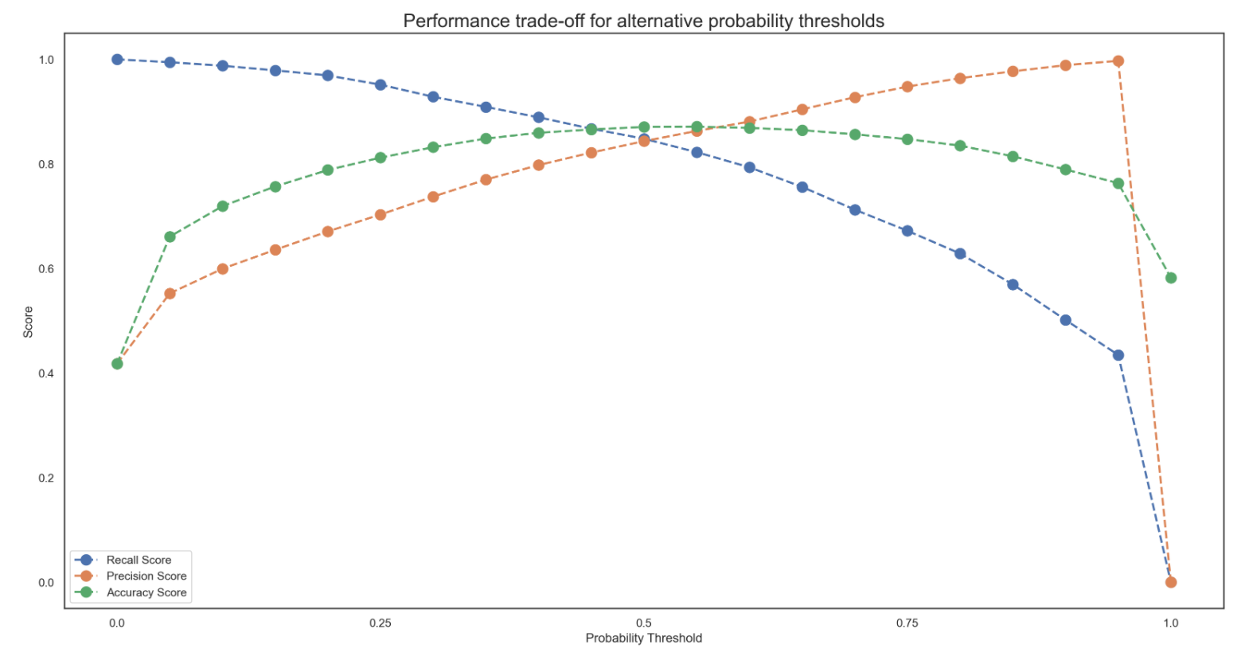
The results show the model has a high level of Accuracy - the % of bookings correctly classified as either cancelations or not. Precision and Recall two other key performance metrics.
There is a tradeoff between how precise the model is - percentage of booking classified as cancelations that will really cancel - and its recall - how many of the future cancelations we are able to flag.
The model chosen shows the highest Accuracy – 88% - while it provides a balance between Precision and Recall – 85% each.
Depending on the intended use the model can be optimized for another metric.
Notes:
Precision is the % of the booking the model classifies as cancelation that will really cancel.

Slide 10
The results show the model can have a high level of Accuracy. Precision and Recall are two other key performance metrics that are very relevant for model implementation.
There is a tradeoff between how precise the model is - percentage of booking classified as cancelations that will really cancel - and its recall - how many of the future cancelations it is able to flag.
The model chosen shows the highest Accuracy – 88% - while it provides a balance between Precision and Recall – 85% each.
Depending on the intended use the model can be optimized for another metric.
1. Optimize for Recall
2. Optimize for Precision
3. Maximum Accuracy
Notes:
It’s a crucial to understand that there is a tradeoff between this 2 metrics- precision and recall.
The model can be optimized for alternative metrics depending on how you want to implement it.

Slide 11
The results show the model can have a high level of Accuracy. Precision and Recall are two other key performance metrics that are very relevant for model implementation.
There is a tradeoff between how precise the model is - percentage of booking classified as cancelations that will really cancel - and its recall - how many of the future cancelations it is able to flag.
The model chosen shows the highest Accuracy – 88% - while it provides a balance between Precision and Recall – 85% each.
Depending on the intended use the model can be optimized for another metric.
1. Flagging larger % of the cancelations
2. More certain it is a cancelation
3. More accurate overall predictions
1. Optimize for Recall
2. Optimize for Precision
3. Maximum Accuracy
Notes:
Let´s now see how business actions can be enabled using the model´s output.

Slide 12
Business Implementation
Integration with PMS DataBase
Support Preventive Action
Enable Booking Management based on Net Demand Forecast
Monitoring & Periodical Maintenance
Integration
Operationalization
Notes:
...
Second is operationalization. There are various ways in which the model can be used to enable better approaches to cancelations management including support for preventive actions or improved net demand forecasting for overbooking policies.

Slide 13






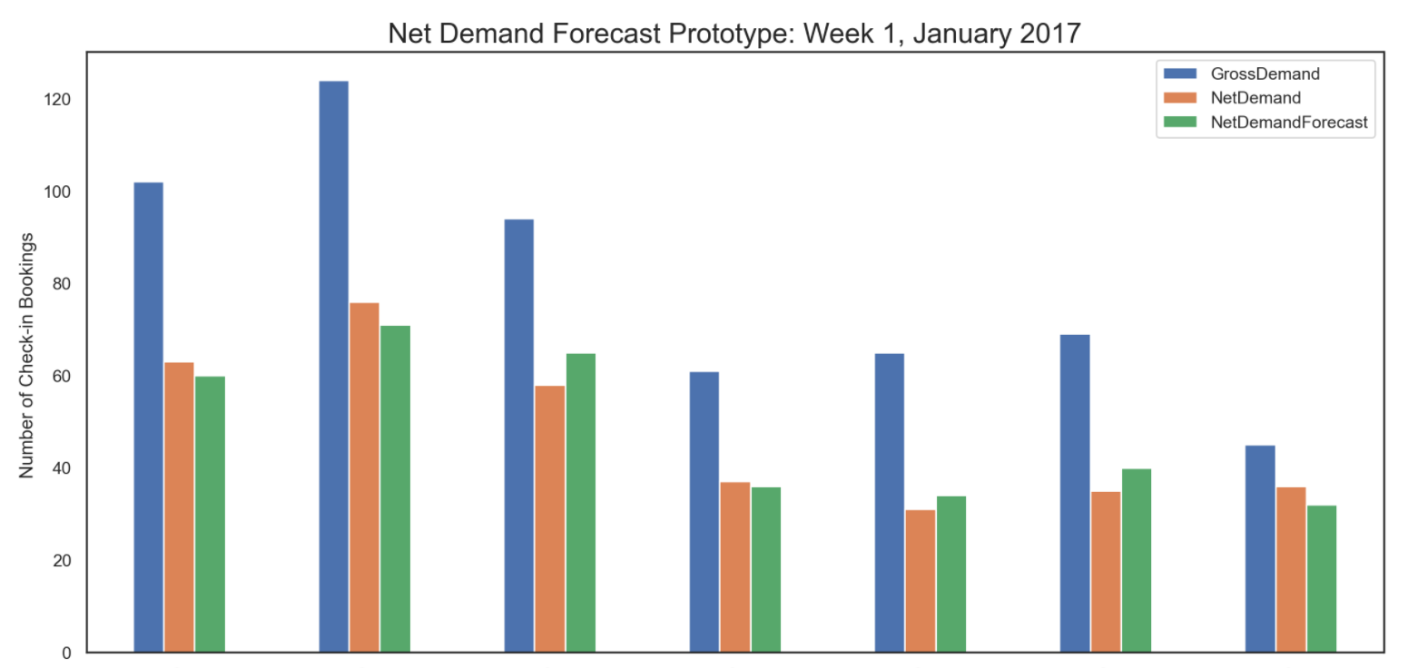


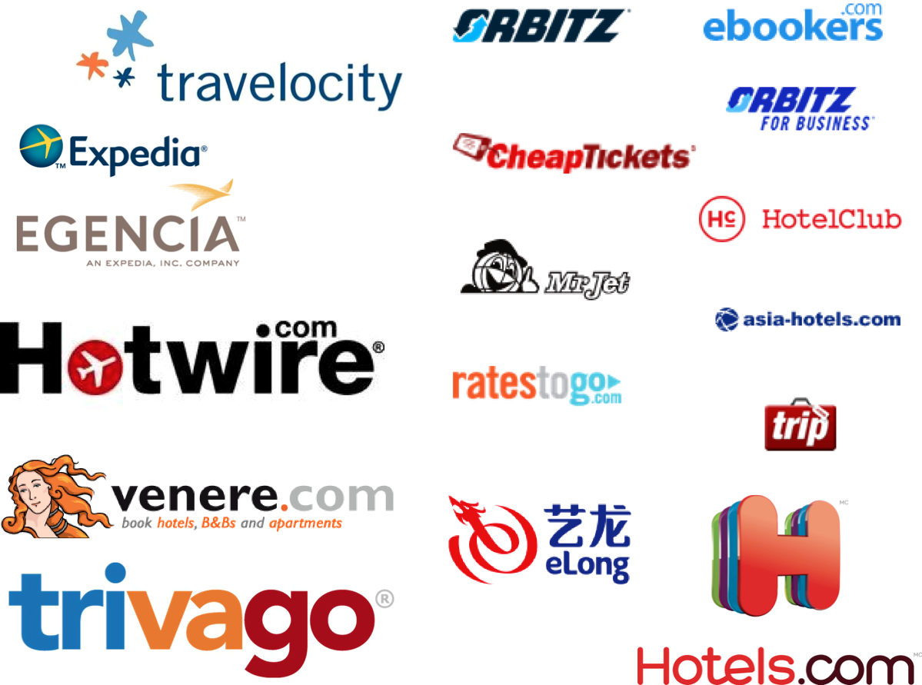
Integration with PMS DataBase due to possible updates in bookings, usage of real-time data
Modeling using real-time data to achieve more effective results and an accurate Net Demand forecast
Build an API that would flag predicted cancelations and update Net Demand forecast (% occupancy)
A booking from the UK was made for 4 adults next weekend and is flagged as likely to be canceled. Should we send them the British Welcome template?
Bookings likely to be canceled
Predictive Model
Net Demand
How many rooms should I expect to have available on April 1st based on current bookings? When should I stop selling?
Bookings
Prediction
Can I update my availability online automatically based on forecasted capacity? I would not miss selling opportunities!
PMS DataBase
Net Occupancy
Notes:
...
3. Managing channel availability: Using the model predictions to update online availability both in our direct channels and connected to the online Travel Agencies APIs
We are also open to discuss your ideas and strongly believe the potential for deploying our model in a way that will benefit your business.

Slide 14

Happy to take your questions

